Slide 1
Notes:
Thanks for coming

Slide 2
CTF Introduction

Slide 3
Ethics
Don’t hack without permission
Active members sign an ethics code every semester! The presence of a vulnerability in a system is NOT an invitation. Thank you.
Notes:
Talk about NCR and how we are trying to get that settup, SOON

Slide 4
What are CTFs?
CTFs, Aka “Capture the Flag”s are a type of Cybersecurity Competitions where you or a team try to collect as many “flags” (strings of text) as you can. An example flag could be: UNRCTF{I_Am_A_Flag}
Depending on the type of competition, this can be doing things like cracking passwords, hacking into a server, exploiting a website, getting intel on something, or more.
There is a CTF For any knowledge level! You do not need to be an avid coder, or a 1337 h@x0r in order to compete! In fact, participating in ctfs are one of the best ways you can learn Cyber Topics.
CTFs can also be done online remotely at any time, or in person.

Slide 5

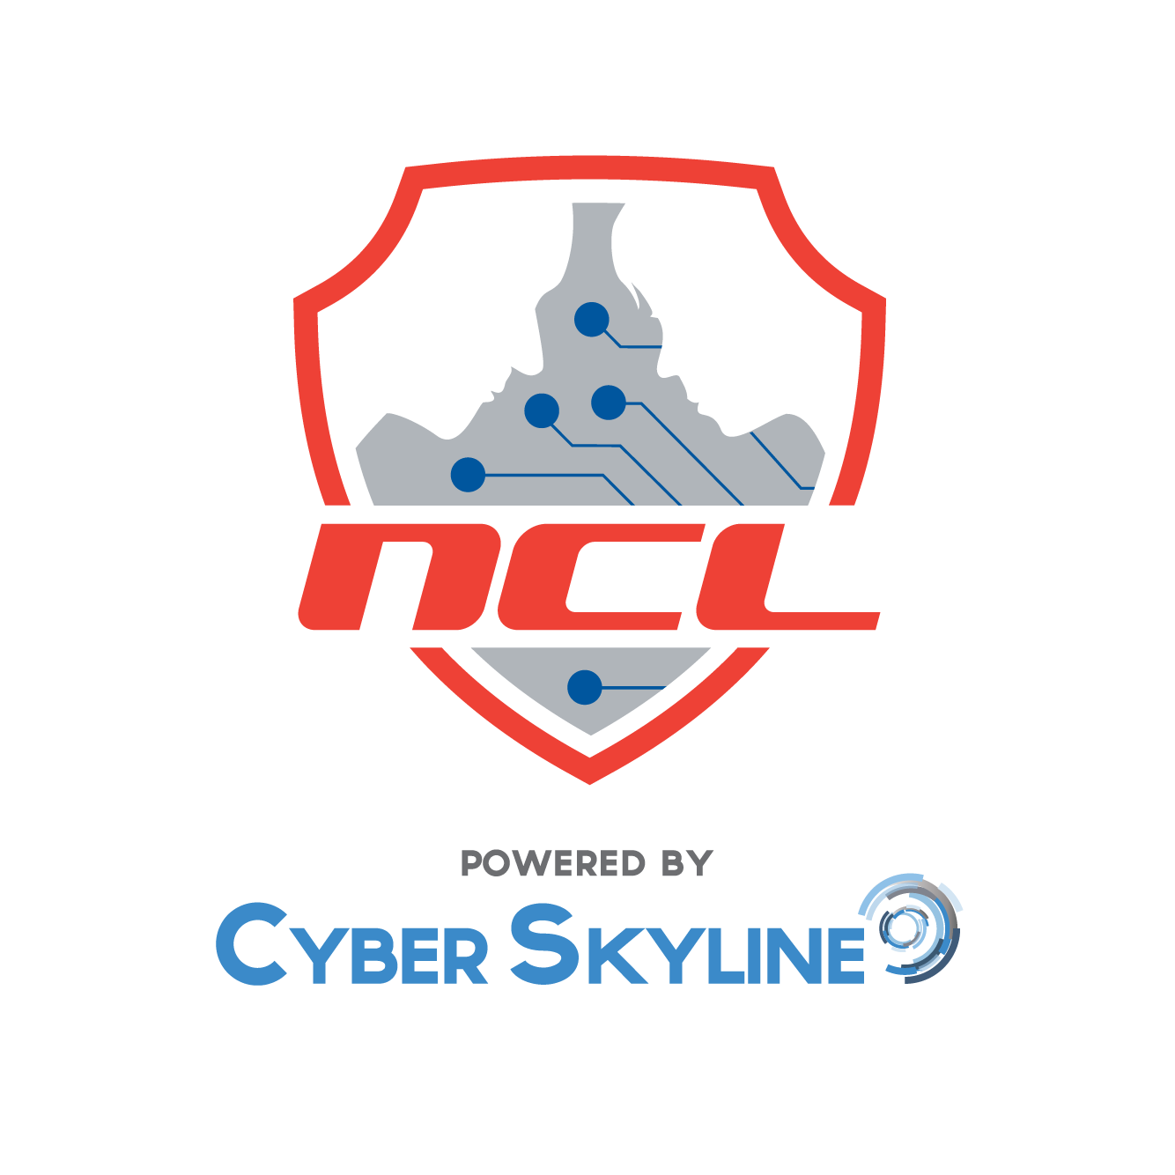




Past Competitions the Club Has Done

Slide 6
Types of CTFs
Attack/Defense (Both or one)
This type of ctf involves either attacking and/or defending servers in order to gain/steal points/flags.
This competition is not recommended for beginners usually but competitions like NCAE make it accessible
Usually everyone gets the same machines so you have to make decisions if you want to exploit a found vulnerability to steal flags or patch it on your system.
Usually involves trying to keep services (like a website) online and functional for points.
Examples: NCAE, CCDC, HackTheBox
Jeopardy-Style
Most Common type of CTF
Best for beginners!
Jeopardy style is where you have a list of challenges you can do from a variety of categories, and by doing them you can obtain the flag.
The team/individual with most flags, wins!
This is what we will be focusing on for the slides.
Examples: Picoctf, NCL, OverTheWire
King of The Hill
This type of competition is where multiple people try to hack into the same server and stay as the “root” or admin user for as long as possible.
Also not recommended for beginners, but there are some beginner machines out there.
It starts as an attack, but quickly become a defense when you are king.
Points are given based on how long you are the root user, though some also give points if you are a regular user.
Examples: TryHackMe, HackTheBox

Slide 7
CTF Benefits
Ctfs are a great way to get started on your journey into cybersecurity, it is where I have done the majority of my learning!
Many employers of cybersecurity look for those who participate in CTFs.
Some competitions have prize money.
They are also a safe and legal way to practice your cyber and hacking knowledge! Again do not hack what you do not have consent to hack.
CTF Sign ups for NCL and any team based ones will be out soon. Things like PicoCTF you don’t need to sign up with us for and can do now!
Notes:
Talk about how we want members to also contribute their knowledge, make workshops tc

Slide 8
Common CTF Categories
(We will have workshops on all of these!)

Slide 9
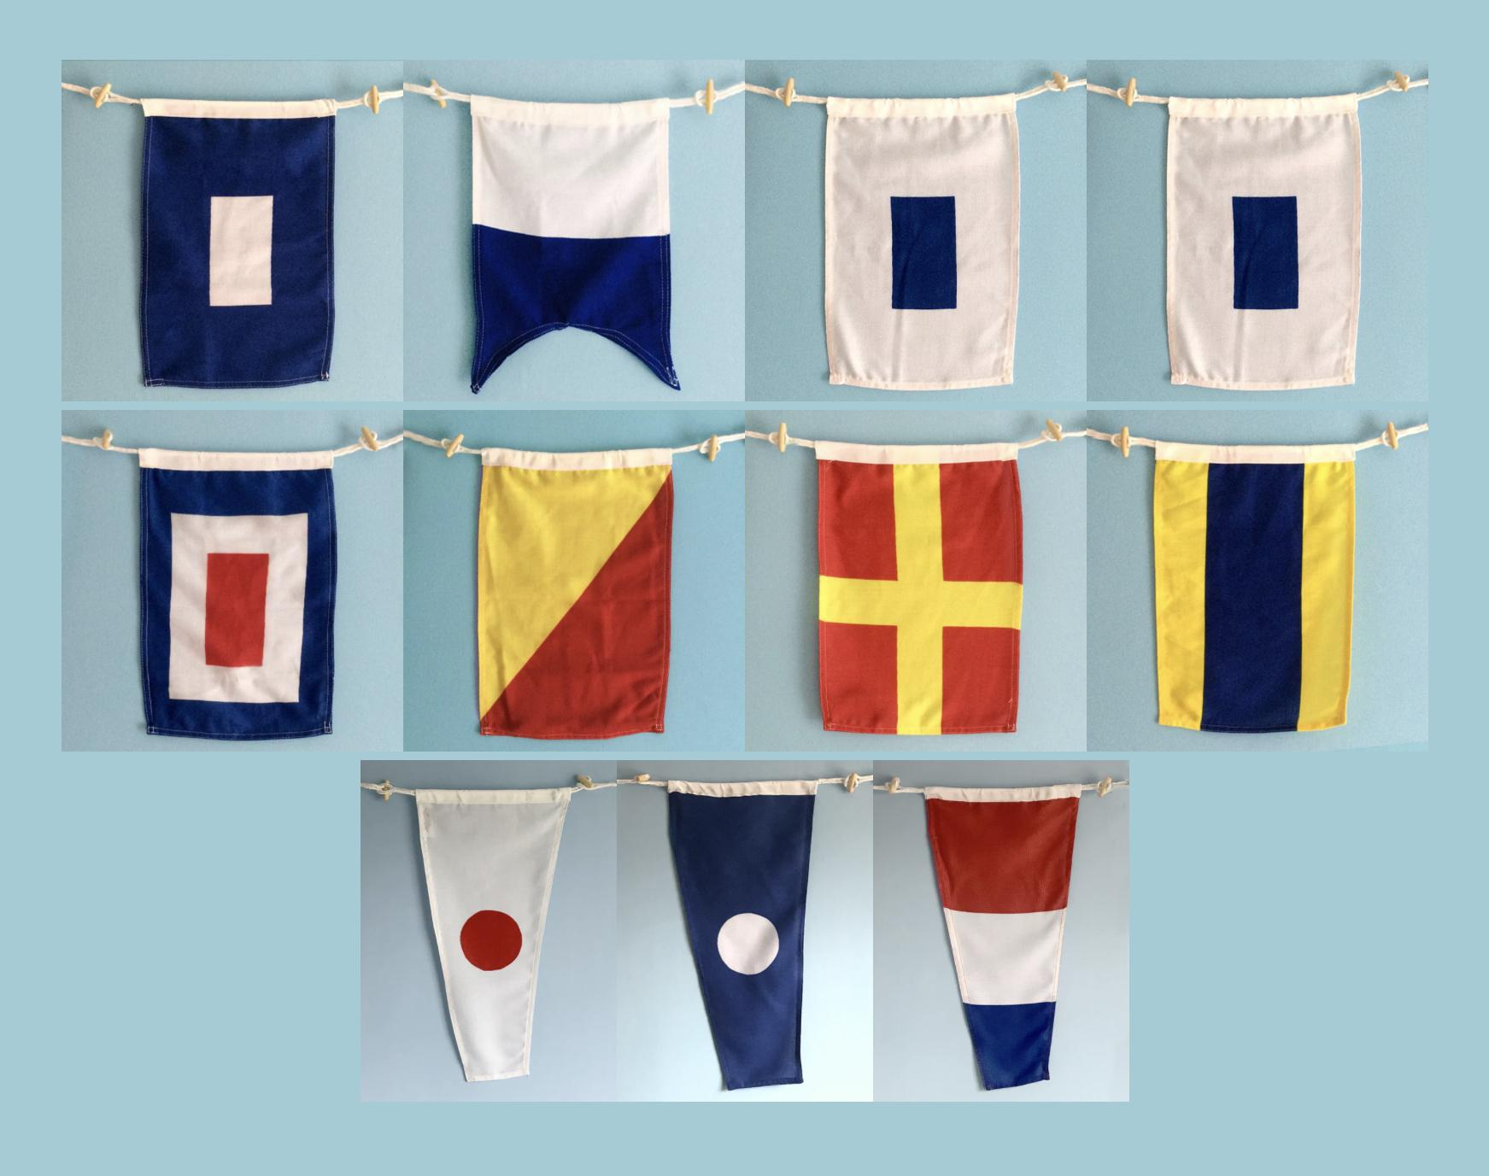
Cryptography
Cryptography Categories involve trying to find what the original message from an encrypted format of some sort. Usually this involves ciphers like Caesar, Vigenere, substitution, etc, or encoding types like base64 and binary, but can include other ways to hide data like this flag cipher.
c2VuZF9tZV90aGVfcGFzc3dvcmRz
... . -. -.. .. -. --.
- .... . --
-. --- .--

Slide 10
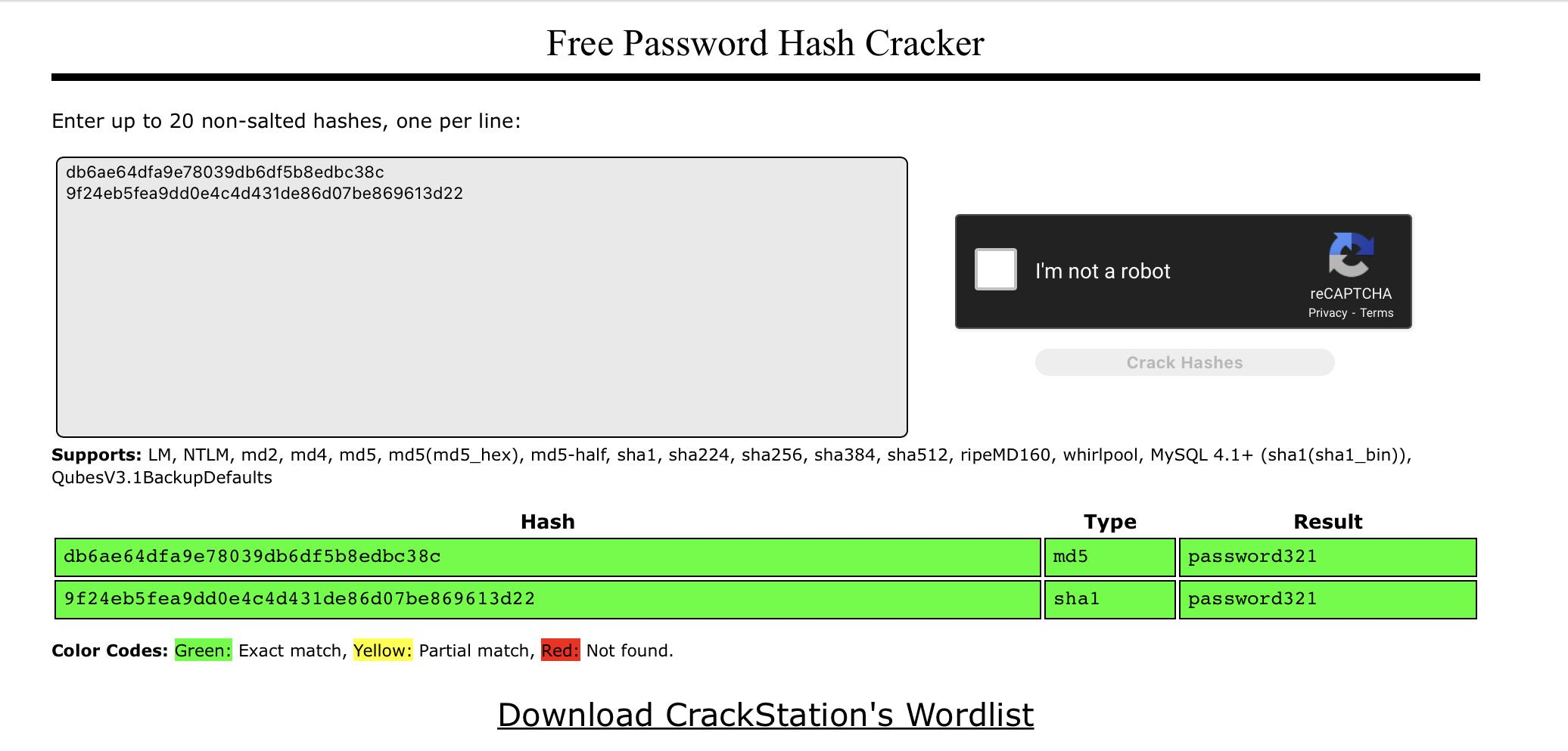
Password Cracking
This Category involves using software (like hashcat) or websites (like crackstation) in order to crack passwords. There can be many different password hash types. This usually comes down to finding/making the right wordlist and rules.
Db6ae64dfa9e78039db6df5b8edbc38c
9f24eb5fea9dd0e4c4d431de86d07be869613d22

Slide 11
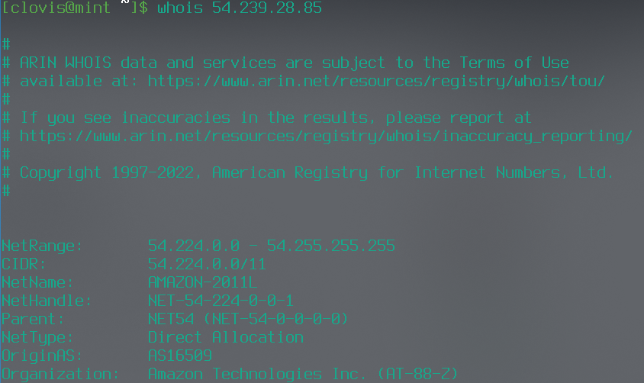
OSINT
OSINT, Also known as Open Source Intelligence, is a category that tests your skills with open source tools (such as google) in order to find information. Even though a lot of OSINT is googling, it can be using open source tools, such as ExifTool to see the location where a photo was taken, or a Cell Tower Search website to find where certain signals came from.
Examples:
Which retailer uses the IP address 54.239.28.85? (amazon, Use “whois”)
Locate where some image is by looking for hints in the image (things like what languages, wall plugs,etc)

Slide 12
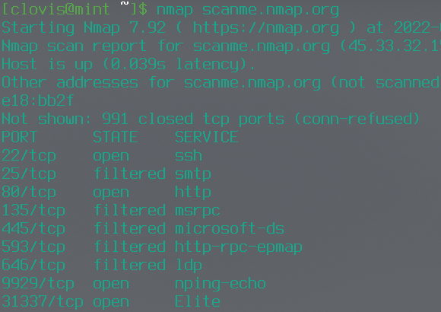
Scanning/Web Enum
This category involves scanning a server (usually with NMAP) or trying to enumerate or see the directories on a website with something like gobuster.
Examples:
What Version of SSH is running on port 22?
What is the flag in the hidden file of the “secret” directory on FakeWebsite.com?

Slide 13
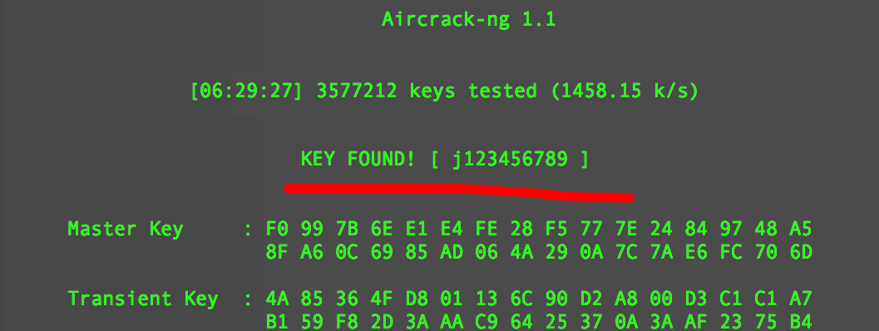
Wireless Access Exploitation/Wifi Cracking
This Category Involves exploiting wireless networks. Usually If a competition is remote, they will give a “pcap” file instead, which is just a file with network traffic in it. This usually involves trying to crack the password using software like Aircrack. Different WiFi Security methods have different cracking methods. (For example, WEP will essentially leak the password with enough packets)

Slide 14
Log File Analysis
This Category has you analysing log files for information. This can be log files from http servers to even Hearthstone/Jackbox games (We did these in the NCL Team game!). It usually requires thinking outside the box and figuring out how to parse the files
Examples:
What IP is responsible for the Bruteforce attack?
Based on the given work logs, which worker most likely exfiltrated the company passwords?
Based on the current times in the log, what is the most likely time the hacker will try to attack again?

Slide 15
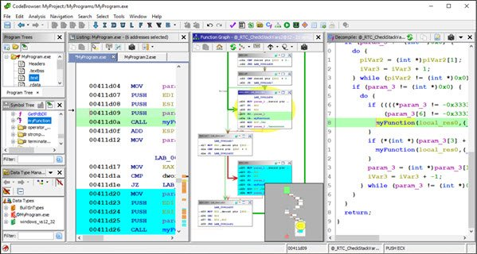
Reverse Engineering
This Category involves reverse engineering code or binaries in order to find out how they work. With software like Ghidra, you usually don’t have to learn assembly, but this tends to be a more difficult category.
Examples:
What is the correct password for the program?
What endpoint does the Discord Token of the victim get sent to?

Slide 16
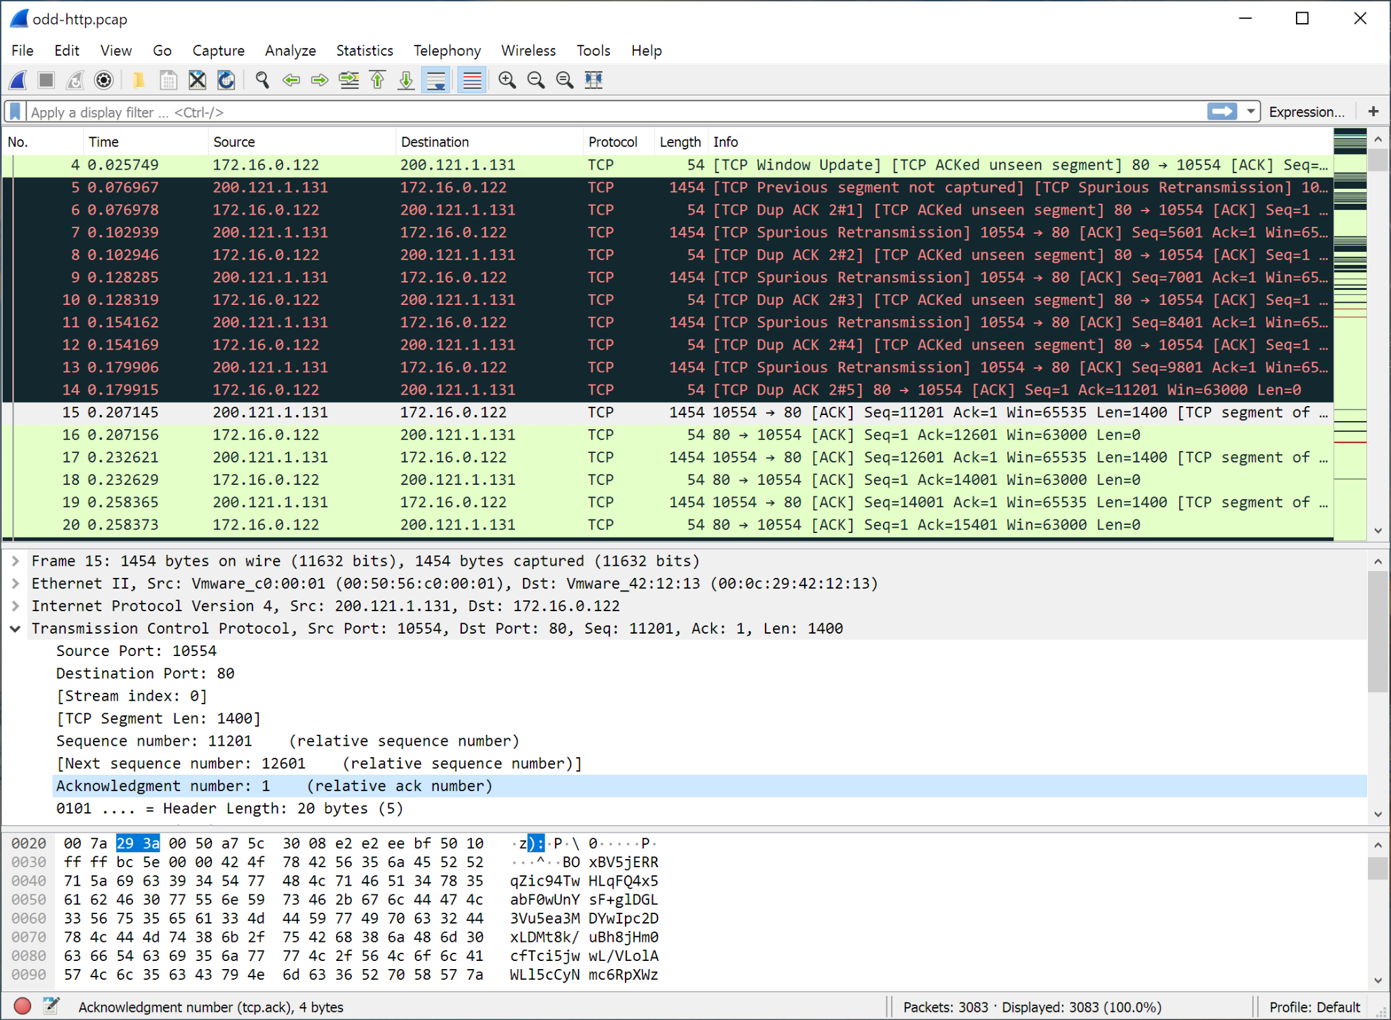
Network Traffic Analysis
This Category involves looking through and analyzing pcap (network traffic) files. Usually you will use WireShark, but other tools might be used like urlsnarf.
Examples:
What IP did the hacker exfiltrate the data to?
What is the password of “John Doe” for “Website.org”?
What Mac Address is responsible for the Deauth attack?

Slide 17
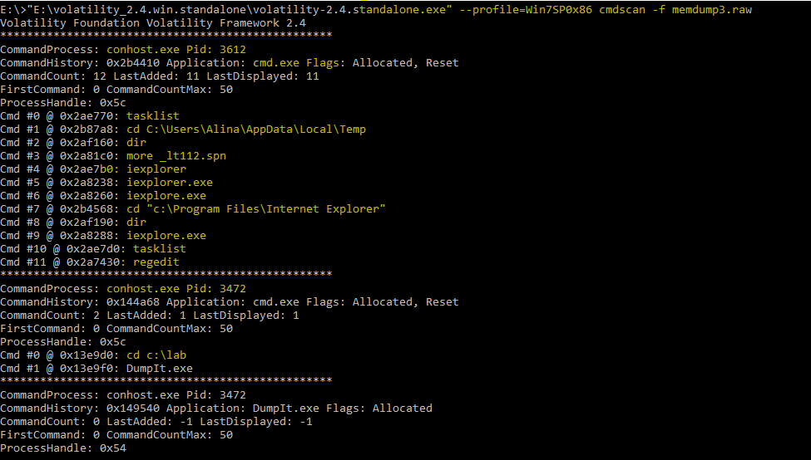
Digital Forensics
This Category involves analyzing files, hard drive, and memory dumps from a system, to find any artifacts left behind. This can be things like file carving, to memory analysis using Volatility.
Examples:
Recovering a full file that was fully deleted, including from recycling bin (yes that is possible!)
What program was being used at the time of this memory capture?
What time did the “Informant” user log in outside of company hours?

Slide 18
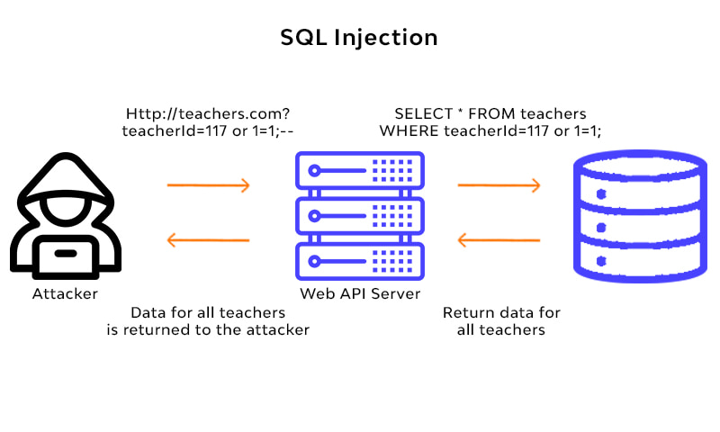
And Lastly, Website Exploitation
This Category involves finding vulnerabilities in webapps in order to gain access to data you should not have, such as password, cause users to do unwanted features, like give you their cookie, or gain access to the server.
Examples:
What is the cookie of the Admin?
What is the flag hidden on the admin page?
What api endpoint allows for command injection?
What is the password for Mike?

Slide 19
CTF Tips
GOOGLE!!!! A lot of people don’t do this enough but nearly every ctf (if not all) allow you to google for things! These aren’t tests or anything. As long as you aren’t sharing answers with people, you will be good. CTFs do NOT expect you to know everything. (There are some osint questions where copying and pasting the question can give you the answer).
Don’t quit if you can only do a no/a few problems. Ctfs are where most people learn things so starting out you may not get that far, but by doing them frequently, you will get farther and farther.
Read writeups! After some competitions, people will release write-ups of solutions. NCL’s gym includes a write up of every problem there as well.
If allowed, ask for help! Unless it's a competition with a leaderboard, usually asking for help (like on the club discord) is fine. If you are unsure, read the rules.

Slide 20
Some Beginner CTFs:
Here is a list of CTFs you can start as soon as the meeting is done! https://docs.google.com/spreadsheets/d/1UklQ9FfpC_lRssCcPQQ7oYlPsbH3dH4NI-_17vF1yn4/edit?usp=sharing
(slides will be posted to discord so you don’t have to try and type this. I will also post this in the discord)

Slide 21
CTF Walkthrough and Q&A

